Slide 1
Day 3, Session 3:
Clustering Techniques

Slide 2
Some notes on notation… (see notation guide)

Slide 3
Clustering methods aim to define sets of data points that belong to the same class or are nearby each other.

Slide 4
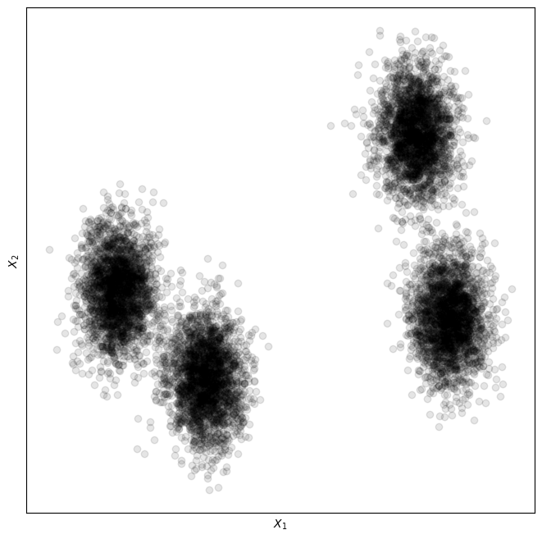
Clustering is generally part of exploratory data analysis (EDA) to understand the data before diving into supervised machine learning.
We can use clustering algorithms to see if our data reflects what we want it to, both in scope and featurization (more on this later)

Slide 5
We will look at clustering algorithms in 3 broad classes.
Density-based
Hierarchy-based
Partition-based

Slide 6
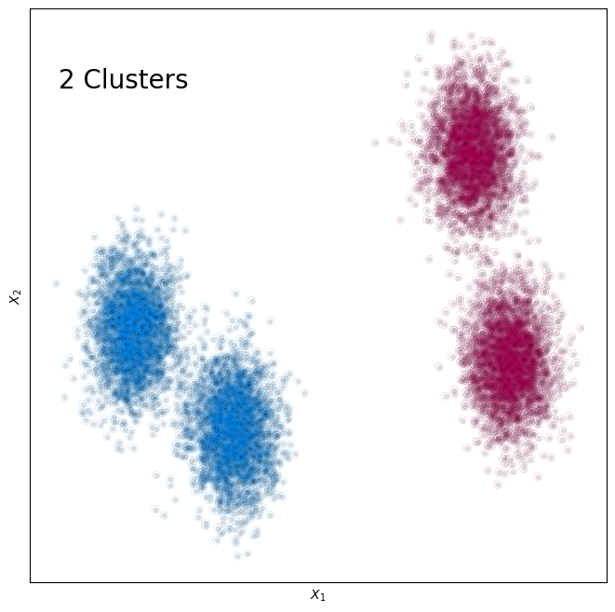
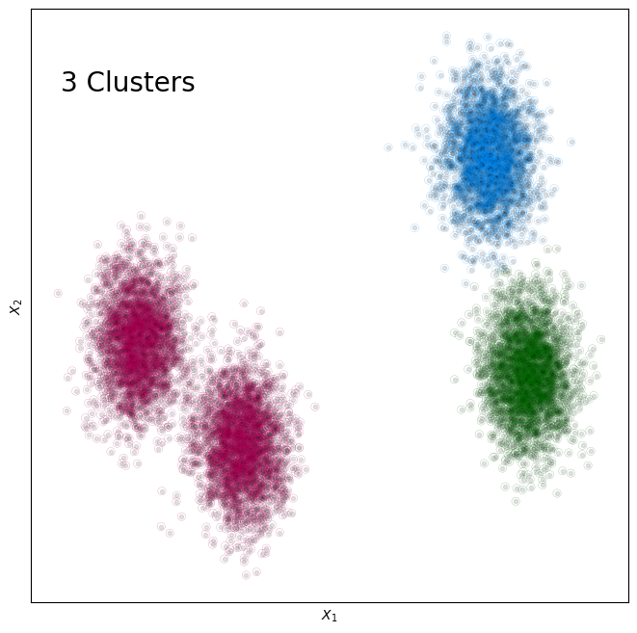
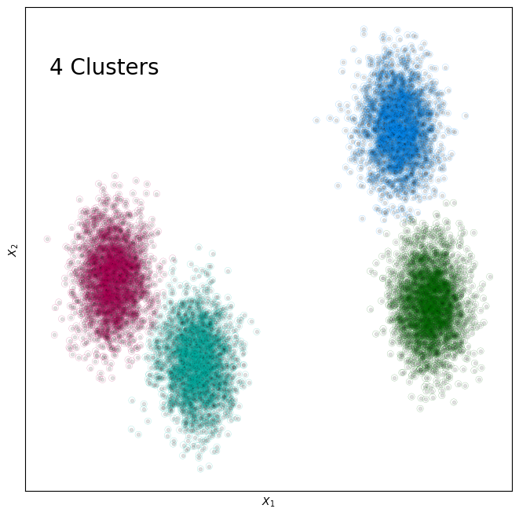
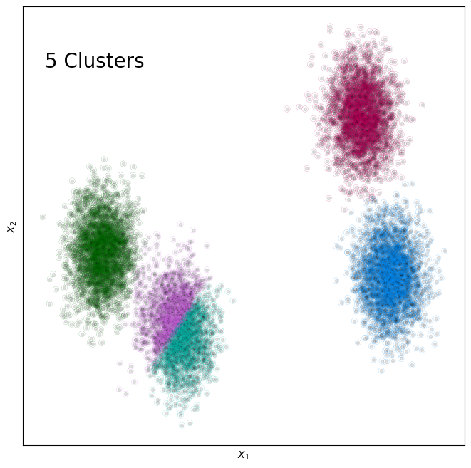
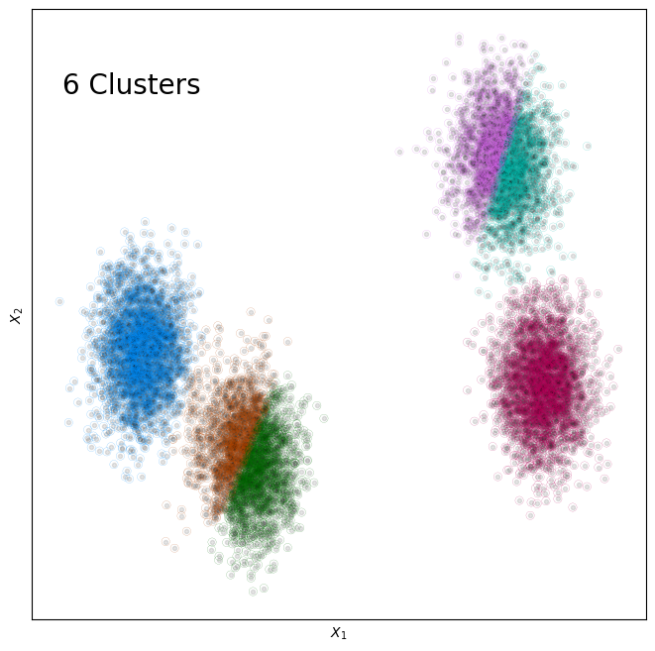
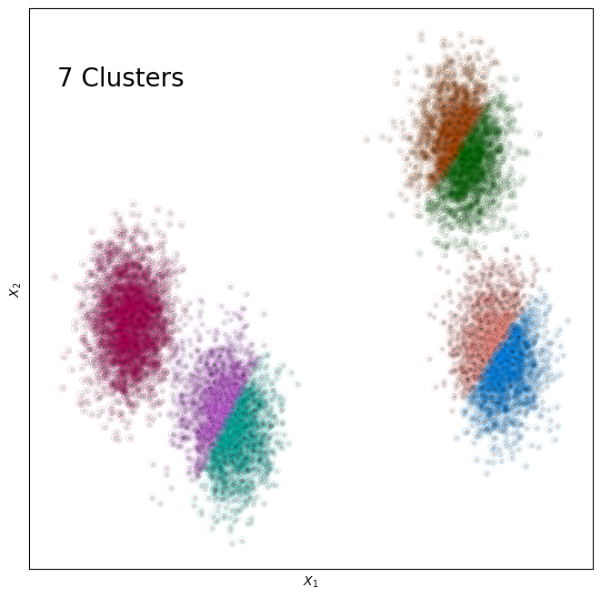
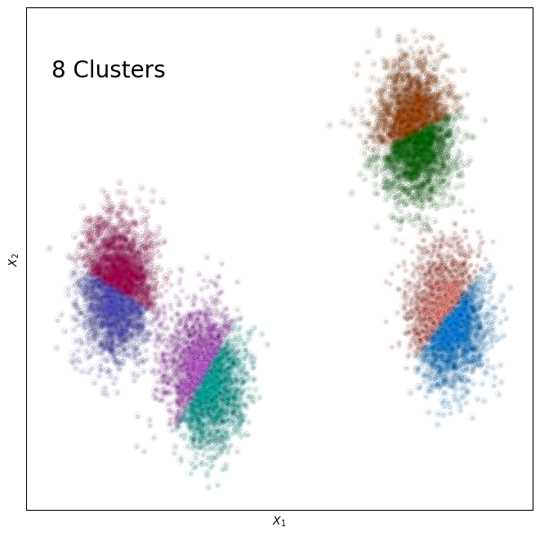
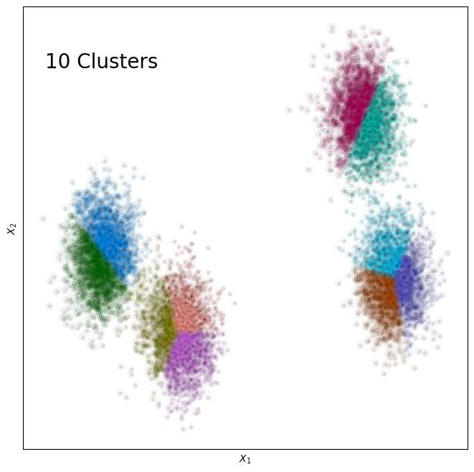
Partition-based clustering defines boundaries between clusters
K-Means clustering takes a specified number of clusters. We then determine clusters by minimizing the in-cluster variance.
sklearn.cluster.KMeans

Slide 7
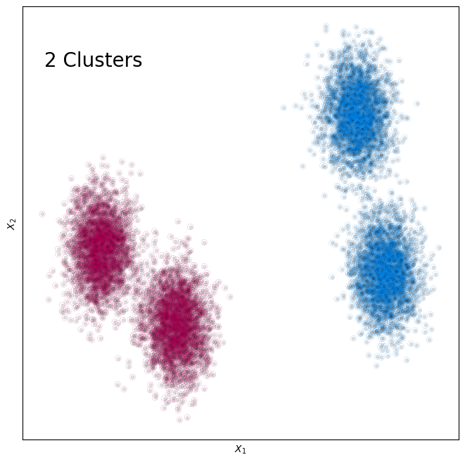
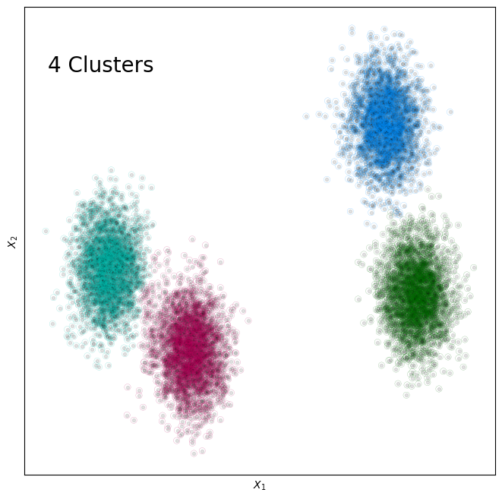

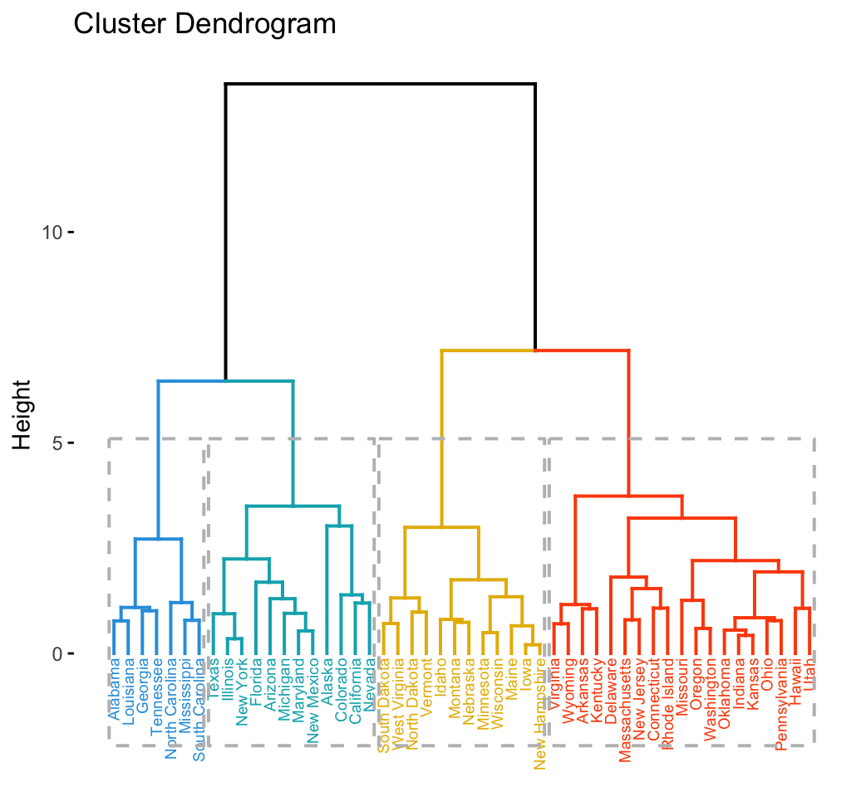
Hierarchical clustering defines clusters from the bottom-up (agglomerative) or top-down (divisive).
In agglomerative clustering, we assume each point belongs to its own cluster, and then we continuously merge similar clusters until some distance or cluster threshold is reached.
sklearn.cluster.AgglomerativeClustering

Slide 8
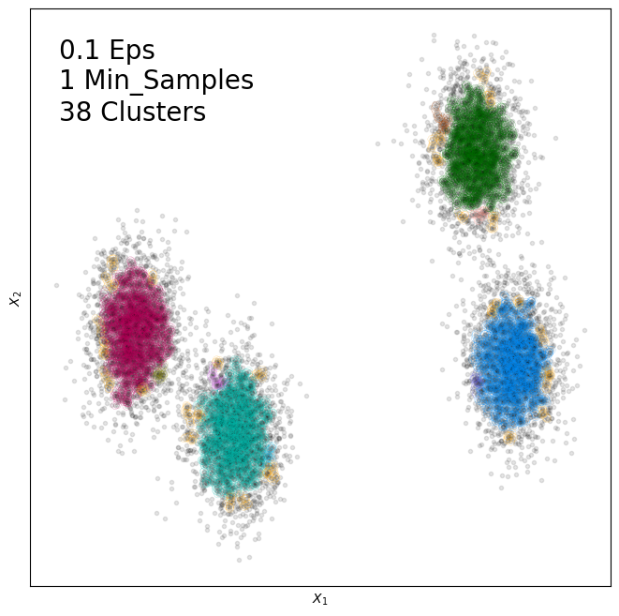
Density-based clustering defines clusters in areas where the density of points is highest.
Density-based spatial clustering of applications with noise (classic backcronym DBSCAN), determines clusters by inflating each data point by radius r, taking each overlapped group with at least min_points members as a cluster.
sklearn.cluster.DBSCAN

Slide 9

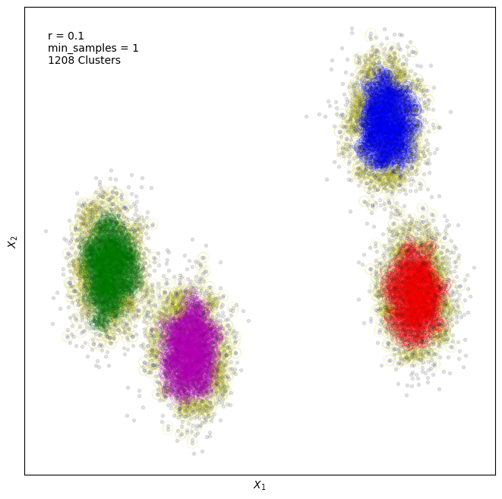
Density-based clustering defines clusters in areas where the density of points is highest.
Density-based spatial clustering of applications with noise (classic backcronym DBSCAN), determines clusters by inflating each data point by radius r, taking each overlapped group with at least min_points members as a cluster.
sklearn.cluster.DBSCAN

Slide 10
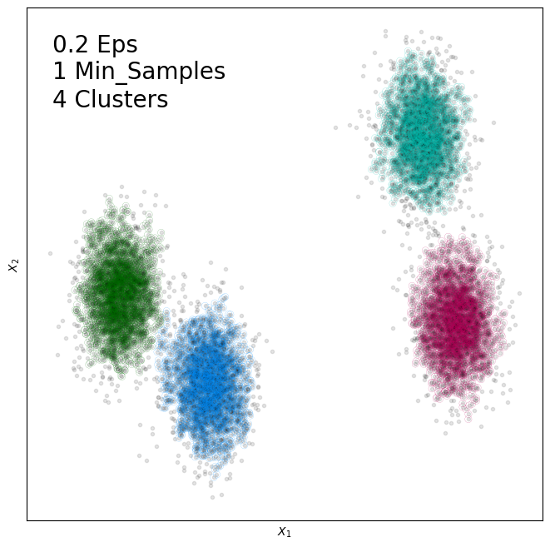
Density-based clustering defines clusters in areas where the density of points is highest.
Density-based spatial clustering of applications with noise (classic backcronym DBSCAN), determines clusters by inflating each data point by radius r, taking each overlapped group with at least min_points members as a cluster.
sklearn.cluster.DBSCAN

Slide 11
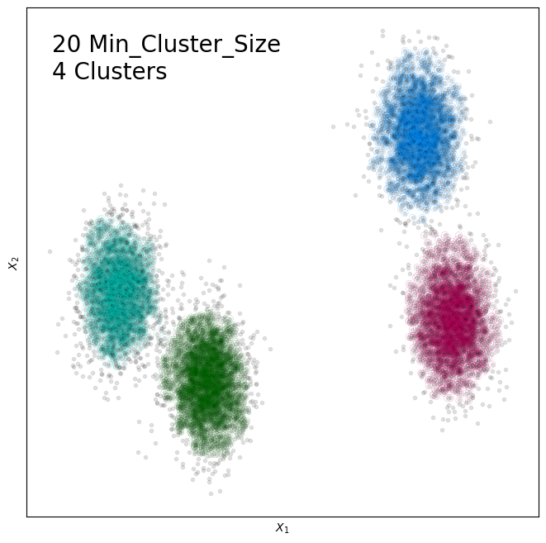
HDBSCAN converts the algorithm of DBSCAN to a hierarchical one, lessening the influence of hyperparameters.

Slide 12
Mean-shift is a density-based algorithm similar to k-means that shifts our centroid based upon data density.

Slide 13
How do we score these clustering algorithms?
This depends on if we know the labels (supervised clustering) or don’t (unsupervised clustering)!
Internal
External
Rand indicator
Fowlkes-Mallows indicator
Jaccard indicator
F indicator
Davies-Bouldin indicator
Dunn indicator
Silhouette coefficient

Slide 14
External indicators focus on how many pairs of points are either correctly or incorrectly put into the same or different clusters.
 | Should be in the same cluster (True) | Should not be in the same cluster (False)
Are put in the same cluster (True) | TP True Positive | FP False Positive
Are put in different clusters (False) | FN False Negative | TN True Negative

Slide 15
 | Should be in the same cluster (True) | Should not be in the same cluster (False)
Are put in the same cluster (True) | 10.3% True Positive | 0.1% False Positive
Are put in different clusters (False) | 14.7% False Negative | 74.9% True Negative

Slide 16
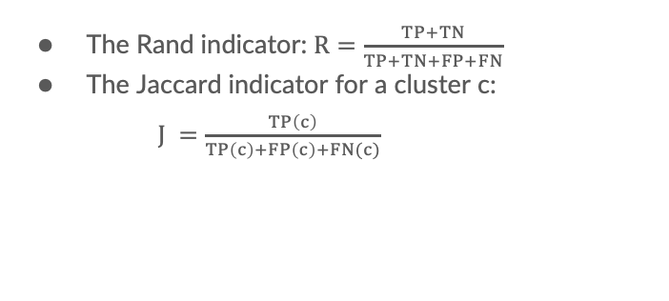
The number of TP, TN, FP, and FN can be used to compute…
 | Should be in the same cluster (True) | Should not be in the same cluster (False)
Are put in the same cluster (True) | 10.3% True Positive | 0.1% False Positive
Are put in different clusters (False) | 14.7% False Negative | 74.9% True Negative
The Rand indicator: $R=\frac{TP+TN}{TP+TN+FP+FN}$
The Jaccard indicator for a cluster c:
$J =\frac{TP\left(c\right)}{TP\left(c\right)+FP\left(c\right)+FN(c)}$
0.852

Slide 17
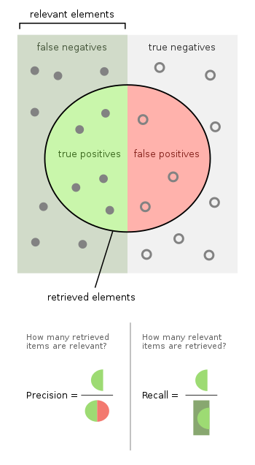
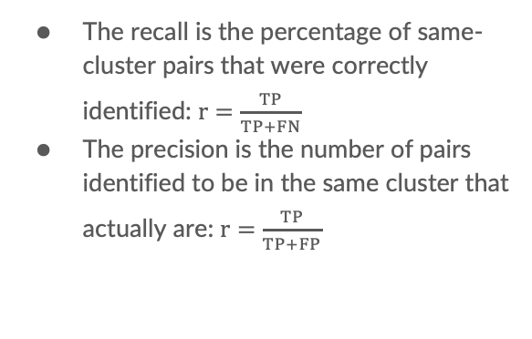
We can also compute the recall and the precision.
The recall is the percentage of same-cluster pairs that were correctly identified: $r=\frac{TP}{TP+FN}$
The precision is the number of pairs identified to be in the same cluster that actually are: $r=\frac{TP}{TP+FP}$
r = 41.2%, p = 99.0%

Slide 18
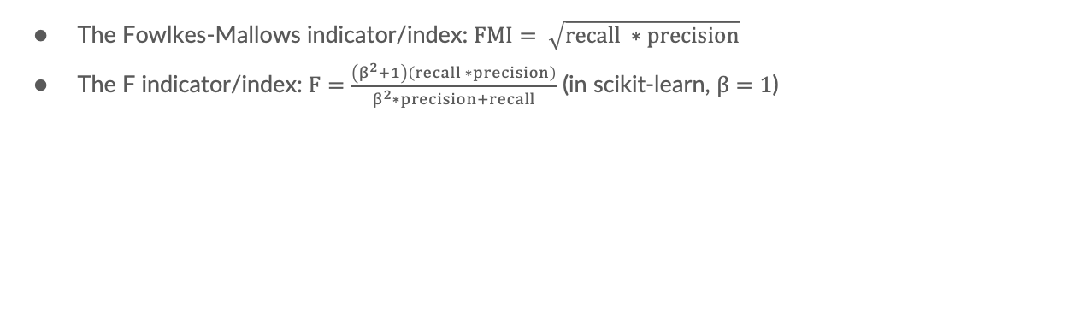
The recall and precision can then be used to compute…
The Fowlkes-Mallows indicator/index: $FMI= \sqrt{recall ∗precision}$
The F indicator/index: $F=\frac{\left(β^{2}+1\right)\left(recall ∗precision\right)}{β^{2}∗precision+recall}$ (in scikit-learn, $β=1$)
0.639
0.582

Slide 19
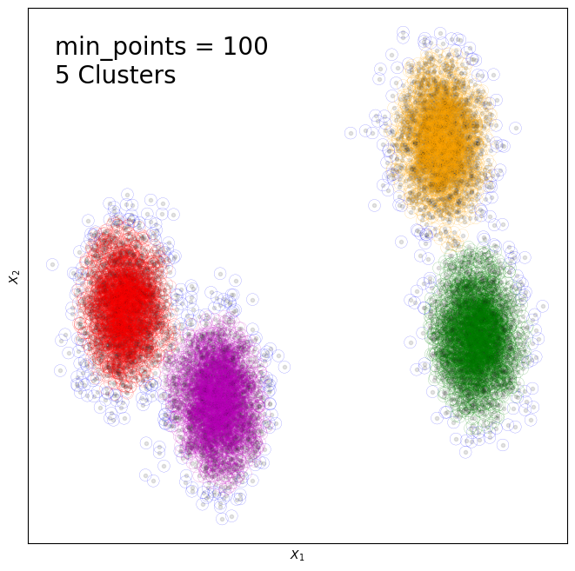
Internal indicators focus on how well-defined and separated each cluster is.
S_{i}
M_{ij}

Slide 20
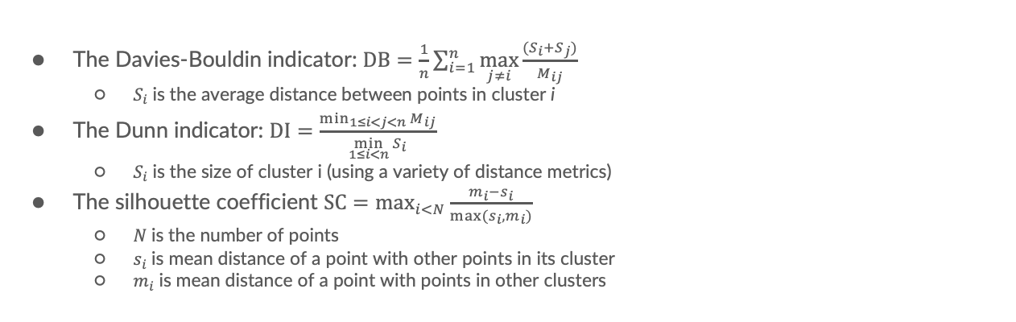
The size measures of cluster, distance between clusters M_{ij}, and # of clusters n are used to compute:
The Davies-Bouldin indicator: $DB=\frac{1}{n}\sum_{i=1}^{n}{\max_{j≠i}\frac{(S_{i}+S_{j})}{M_{ij}}}$
$S_{i}$is the average distance between points in cluster i
The Dunn indicator: $DI=\frac{\min_{1≤i<j<n}{M_{ij}}}{\min_{1≤i<n}{S_{i}}}$
$S_{i}$is the size of cluster i (using a variety of distance metrics)
The silhouette coefficient $SC=\max_{i<N}{\frac{m_{i}−s_{i}}{max⁡(s_{i},m_{i})}}$
$N$is the number of points
$s_{i}$is mean distance of a point with other points in its cluster
$m_{i}$is mean distance of a point with points in other clusters

